Slide 2
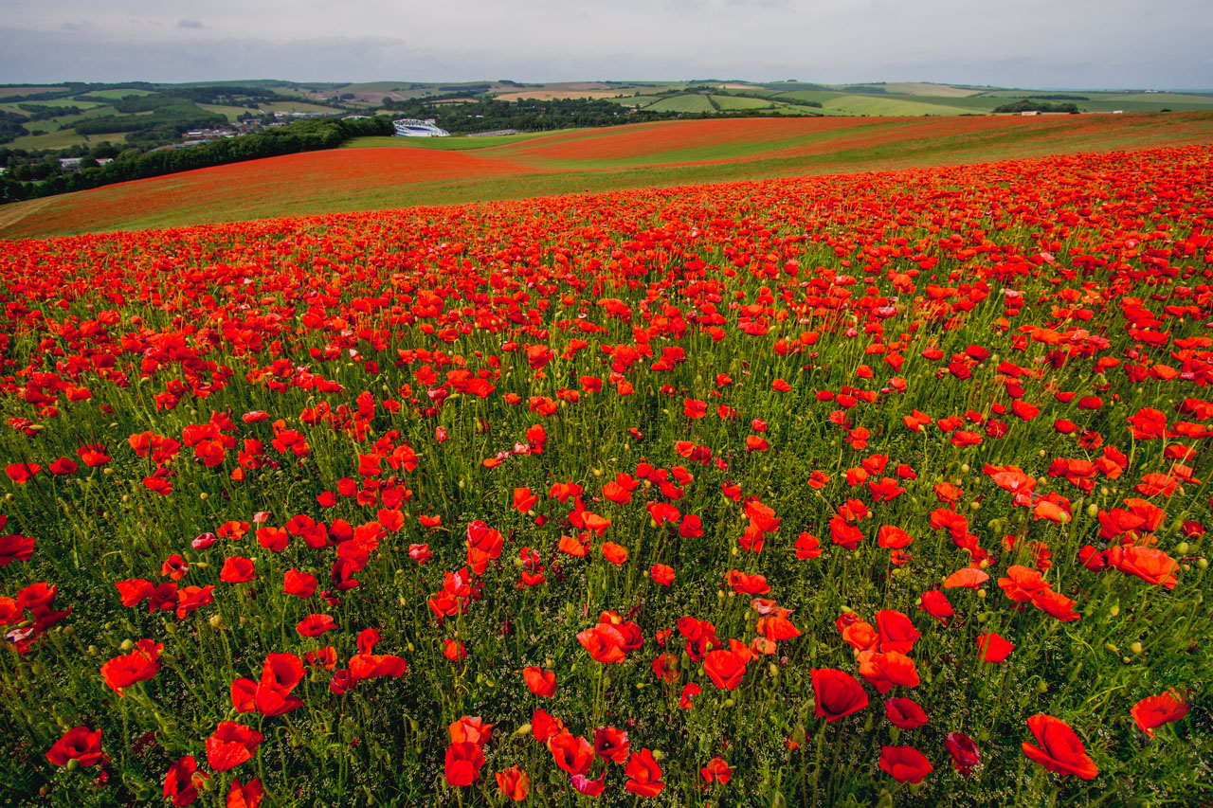
Today we are thinking about everyone who died in a war that ended a hundred years ago.

Slide 3
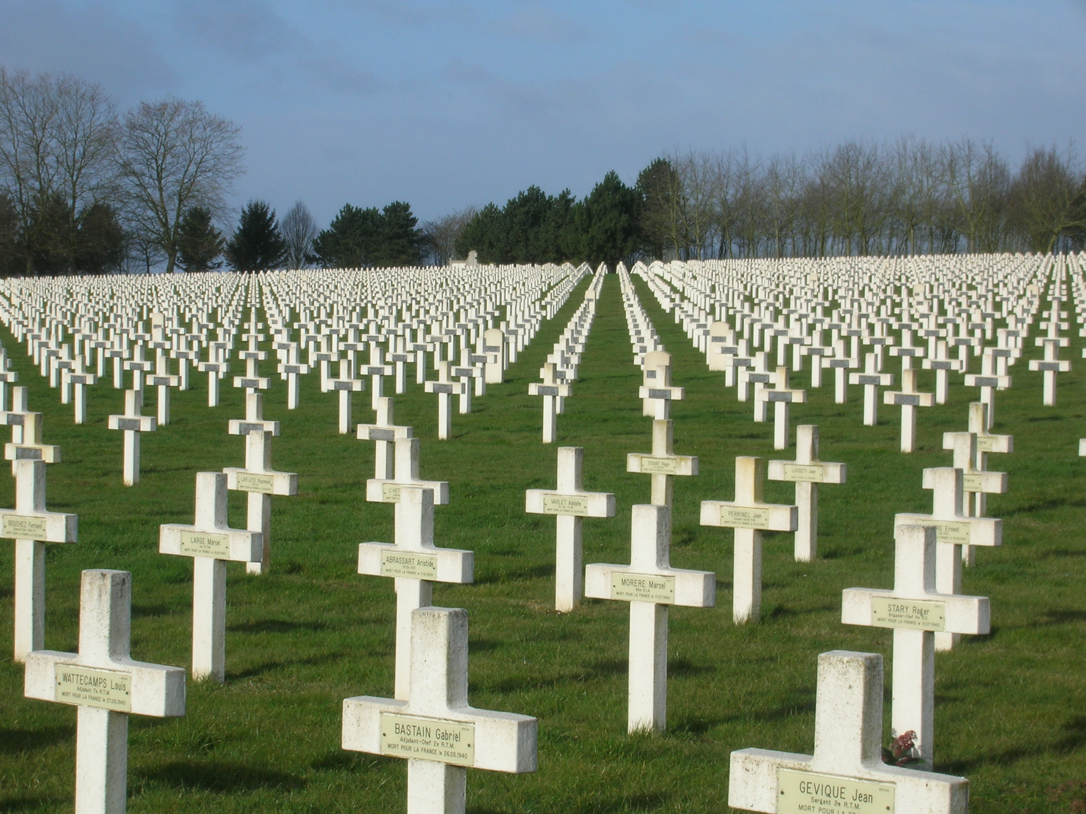

Slide 4
Today we are thinking about everyone who was hurt or injured during that war - the First World War.

Slide 5
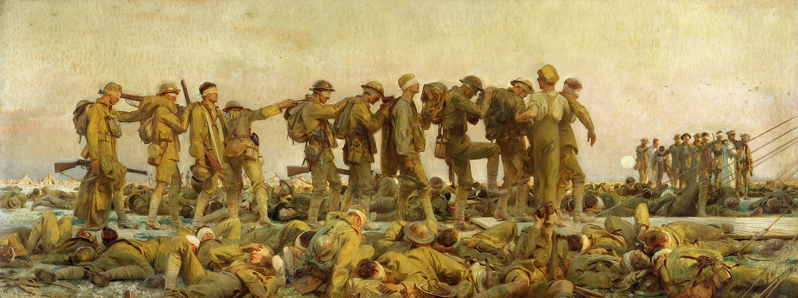

Slide 6
Today we are thinking about everyone who managed to keep going while the War was going on.

Slide 7
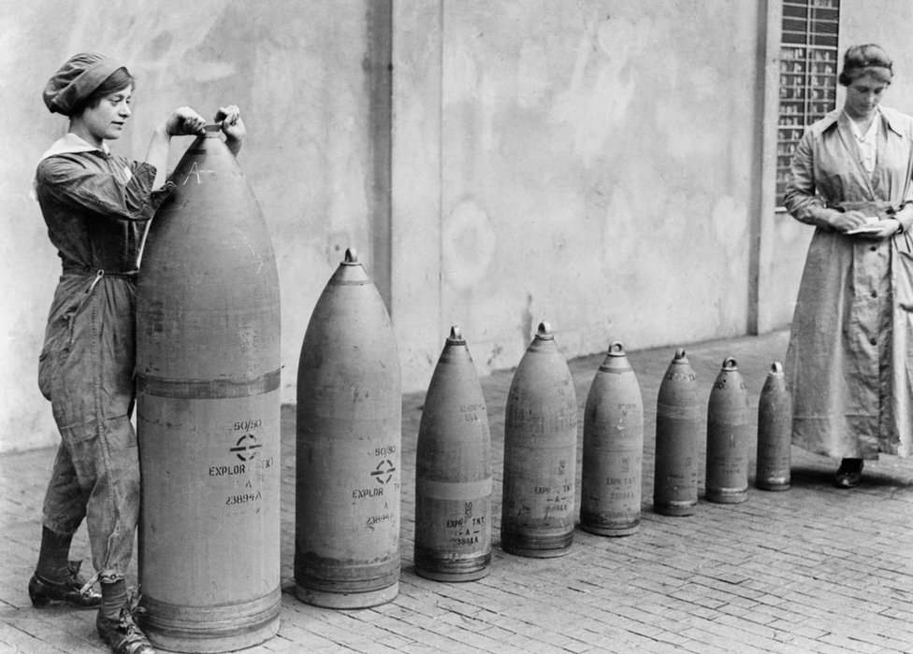
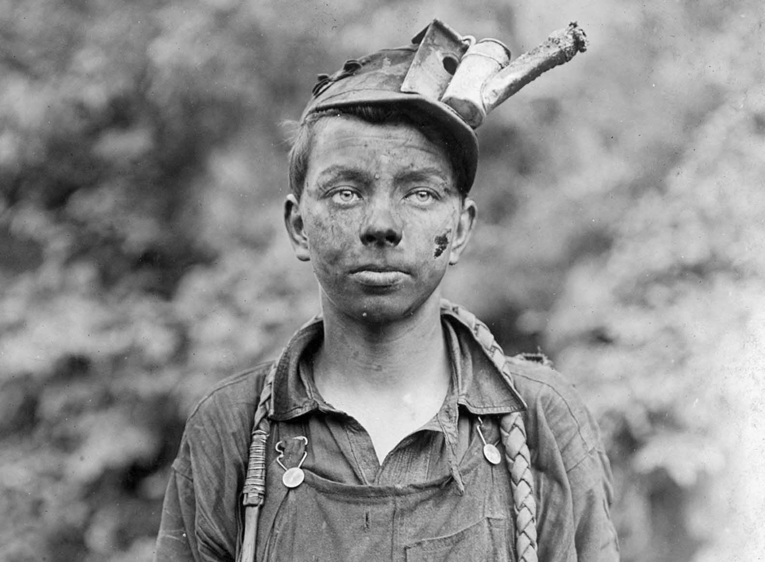
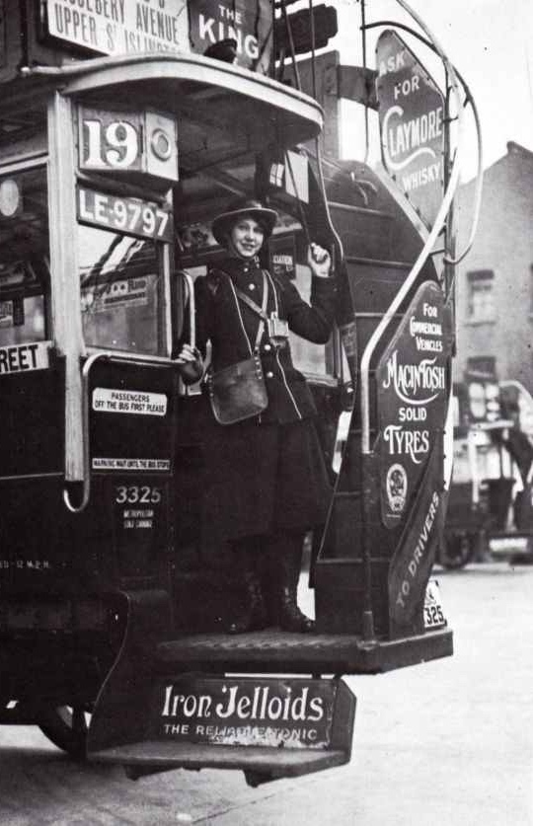

Slide 8
Today, in fact, we are thinking about everyone who has suffered because of any war, anywhere in the world.

Slide 9
At the going down of the sun
And in the morning
We will remember them.
Laurence Binyon

