Slide 2
The First World War ended a hundred years ago this month.

Slide 3
But not until millions of people had died.

Slide 4
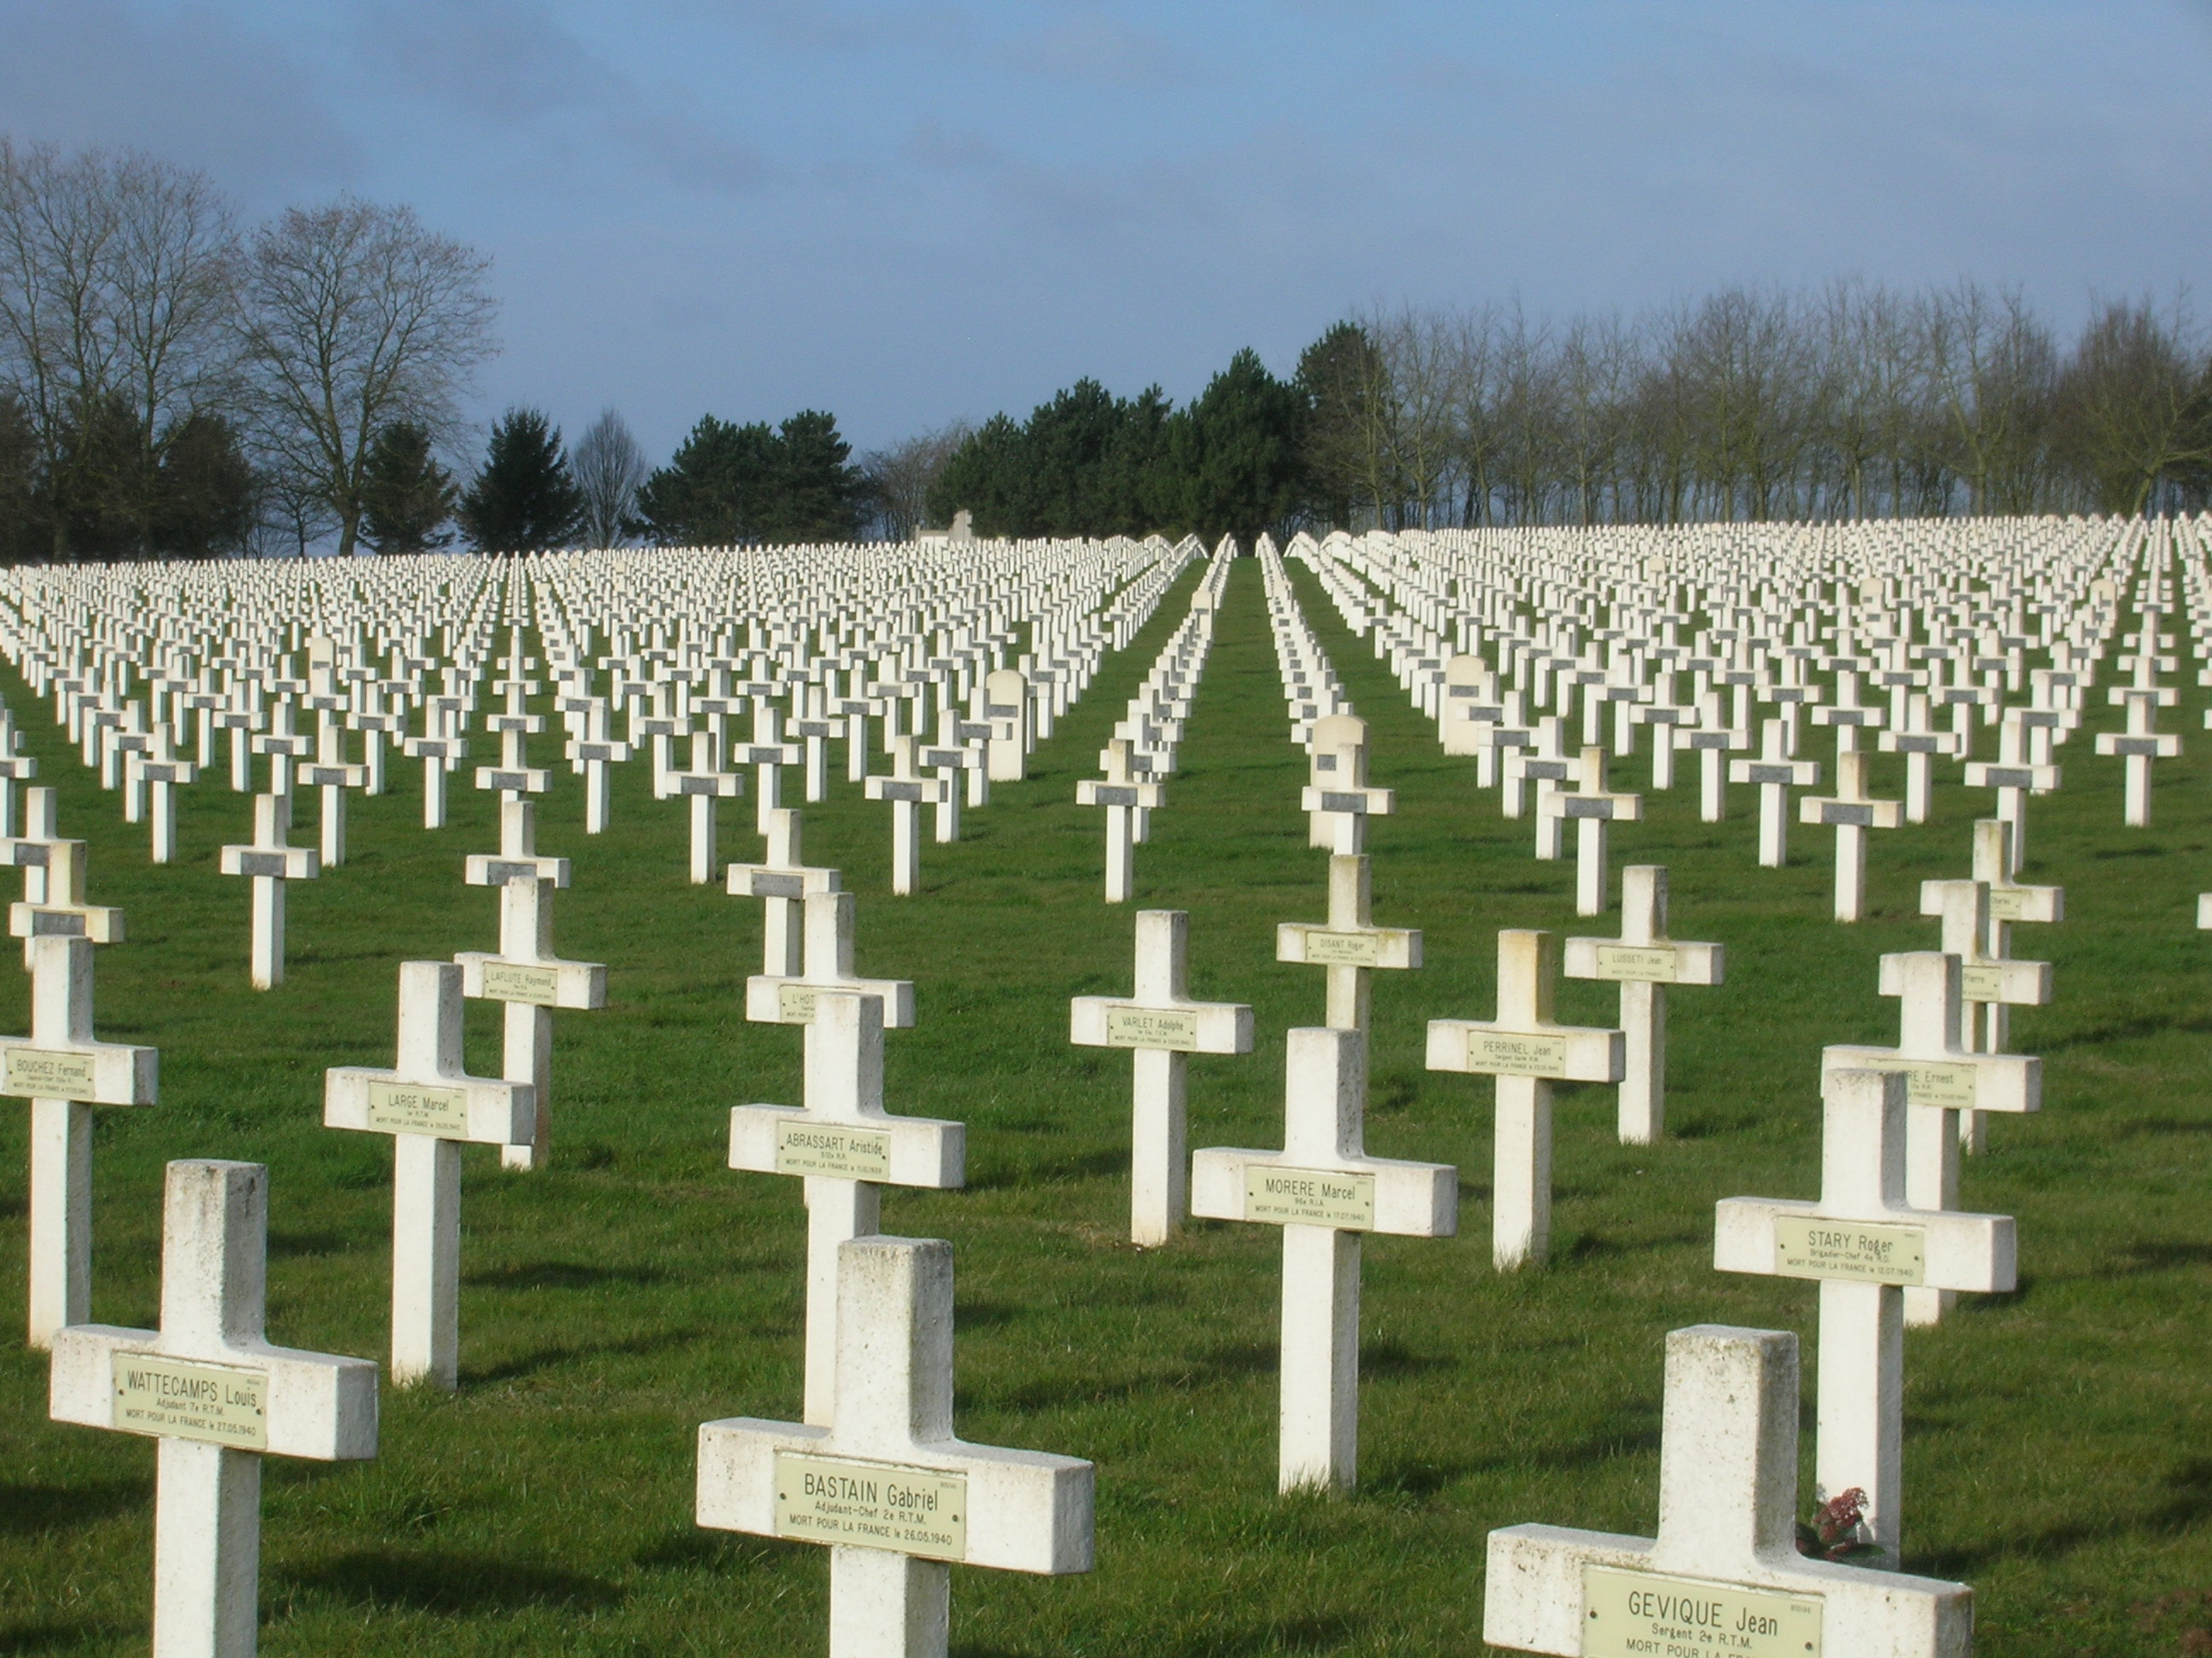

Slide 5
In France, Private Edward Barber died after a grenade attack. He was awarded the Victoria Cross for his bravery.

Slide 6
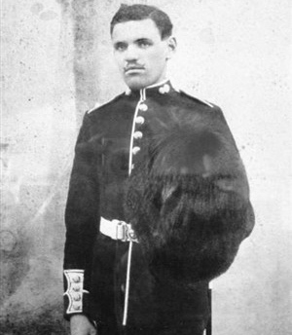
Edward Barber

Slide 7
In Belgium, a nurse called Edith Cavell was executed after helping injured British soldiers escape back home.
Edward Barber

Slide 8
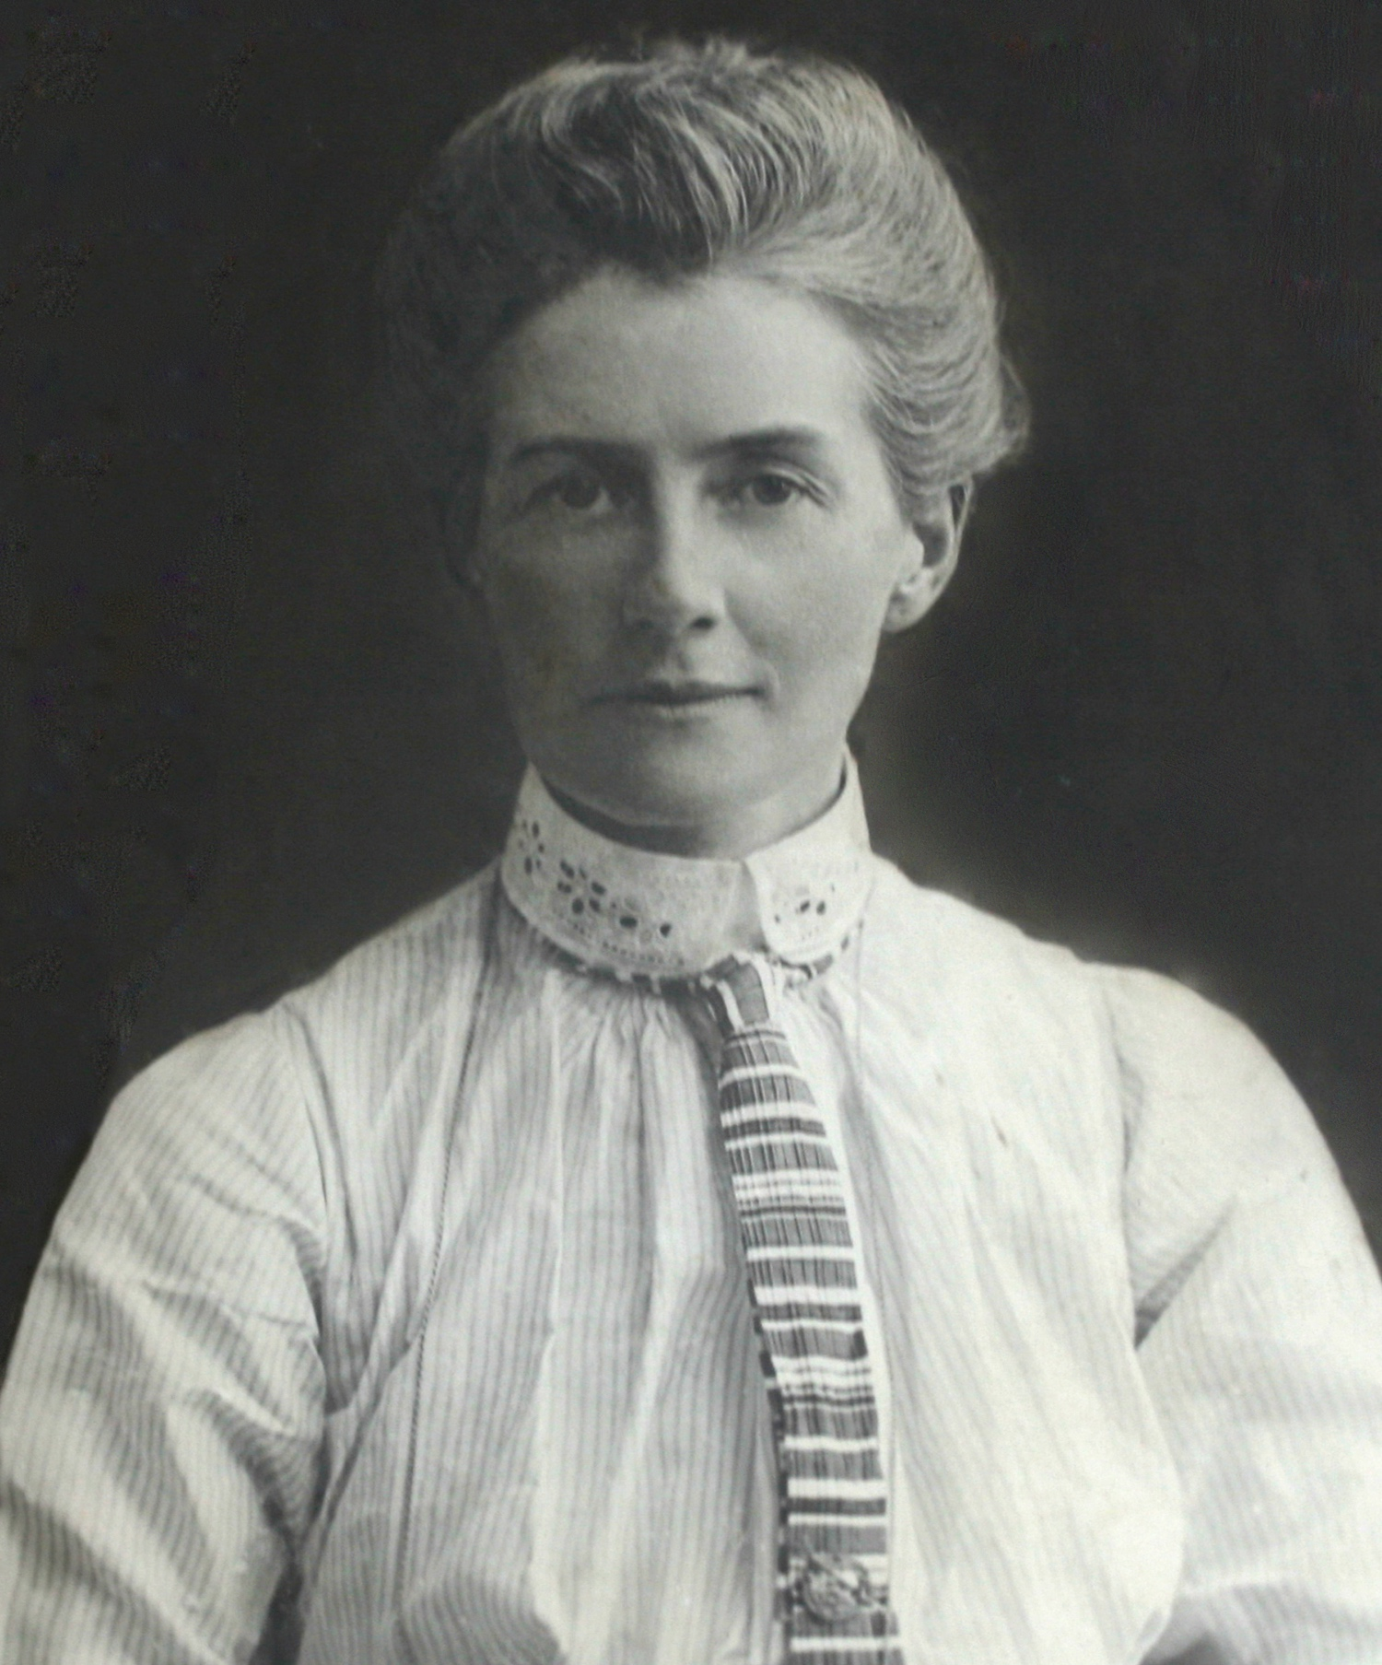
Edward Barber
Edith Cavell

Slide 9
In England, 73 workers, mostly women, died when their munitions factory exploded.

Slide 10
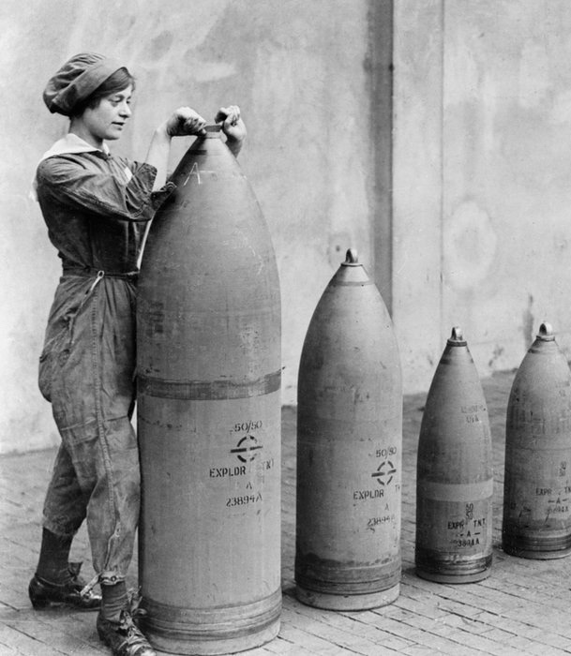
1917 Silvertown Disaster

Slide 11
In Scotland in 1918, 9,000 people died from Spanish Flu - brought back from the battlefields of Europe.
1917 Silvertown Disaster

Slide 12
1917 Silvertown Disaster
9,000 Scottish civilians dead

Slide 13
These people represent everyone who has suffered because of any war, anywhere in the world.

Slide 14
At the going down of the sun
And in the morning
We will remember them.
Laurence Binyon

